Slide 1

RETHINKING REGIONAL ATTRACTIVENESS in EASTERN MACEDONIA – THRACE
Gwendaline Jossec
Senior Economist & Policy Analyst – Regional attractiveness case studies coordinator
Centre for Entrepreneurship, Small Business, Regions and Cities (CFE)
Organisation for Economic Cooperation and Development (OECD)

Slide 2

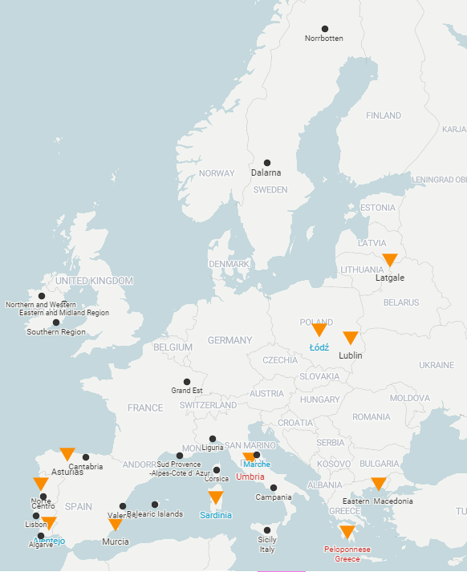
Eastern Macedonia-Thrace’s participation in context:
A community of practice of 30+ regions in 15 countries (and counting)
2024-2025: EU-funded project
for 11 regions in 6 countries
SWEDEN
Dalarna
Norrbotten
Greece | Eastern Macedonia –Thrace^ Peloponnese*
Italy | Sardinia** Umbria*
Latvia | Latgale^
Poland | Lubelskie^ Łodzkie**
Portugal | Alentejo** Norte
Spain | Asturias Murcia
IRELAND
Eastern & Midland
Northern & Western
Southern
FRANCE
Corsica
Grand Est
Sud/PACA
La Réunion
LATVIA
Latgale
POLAND
Łodzkie
Lubelskie
PORTUGAL
Alentejo Algarve
Centro
Lisbon
Norte
IT
GREECE
Eastern Macedonia-Thrace
Peloponnese
GUATEMALA
Escuintla
SPAIN
Asturias
Balearic Islands Cantabria
Murcia
Valencia
ITALY
Campania
Liguria
Marche
Sardininia
Sicily
Umbria
MOROCCO
Tanger-Tetouan Al-Hosseima
COLOMBIA
Pacífico
CHILE
Valparaíso Magallanes
ARGENTINA
Misiones
*Region in a ‘Development trap’​
**Region in a ‘Talent Development trap’
^ EU Border region​

Slide 3
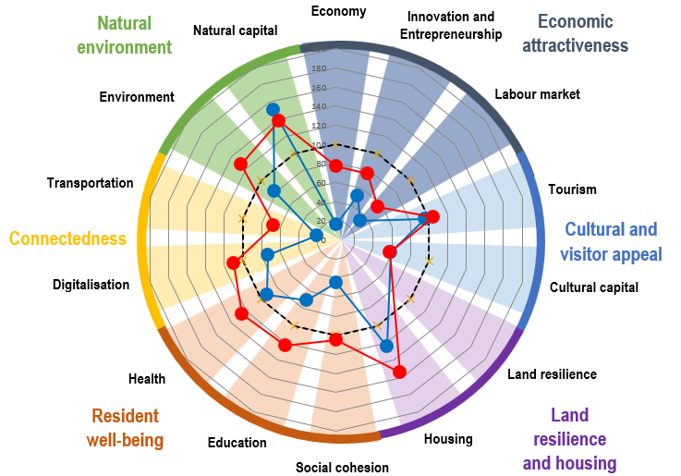
Eastern Macedonia-Thrace’s Attractiveness Compass
Attracting talent, visitors, and investors is key to regions’ sustainable, inclusive development
Regional attractiveness depends on many factors: 60+ indicators across 14 dimensions, grouped into 6 broad domains.
attractiveness
How to read the compass:
A higher score (max. 200) indicates better performance to other regions, with the median as 100 (black dotted line).
The red line shows performance relative to the rest of the country.
The blue line shows performance relative to other EU regions.

Slide 4
Policy considerations for Eastern Macedonia-Thrace
Unlock the commercial potential of the Port of Alexandroupoli by ensuring locally relevant infrastructure development, promoting dual-use technology, and increasing local linkages.
Better leverage Eastern Macedonia-Thrace’s industrial zones and incubators, seeking to deepen their regional linkages through targeted policies and partnerships.
Develop a comprehensive regional strategy for attracting, training, and retaining talent in Eastern Macedonia-Thrace, adapting initiatives to relevant groups and territorial levels.
Use the new thematic routes to promote sustainable, year-round tourism and more balanced regional development, leveraging the region’s under-tapped natural and cultural assets.
Address administrative gaps in the assessment of investment proposals, incorporating a regional lens across the board.
Strengthen the capacities of regional and local authorities to conduct consultation processes, monitor and evaluate attractiveness policies and programmes, and develop regional strategies at different time horizons.
INVESTORS
TALENT
VISITORS
attractiveness
MULTI-LEVEL GOVERNANCE

Slide 5

Thank you
Visit our website: https://www.oecd.org/fr/regional/globalisation.htm

